Slide 1
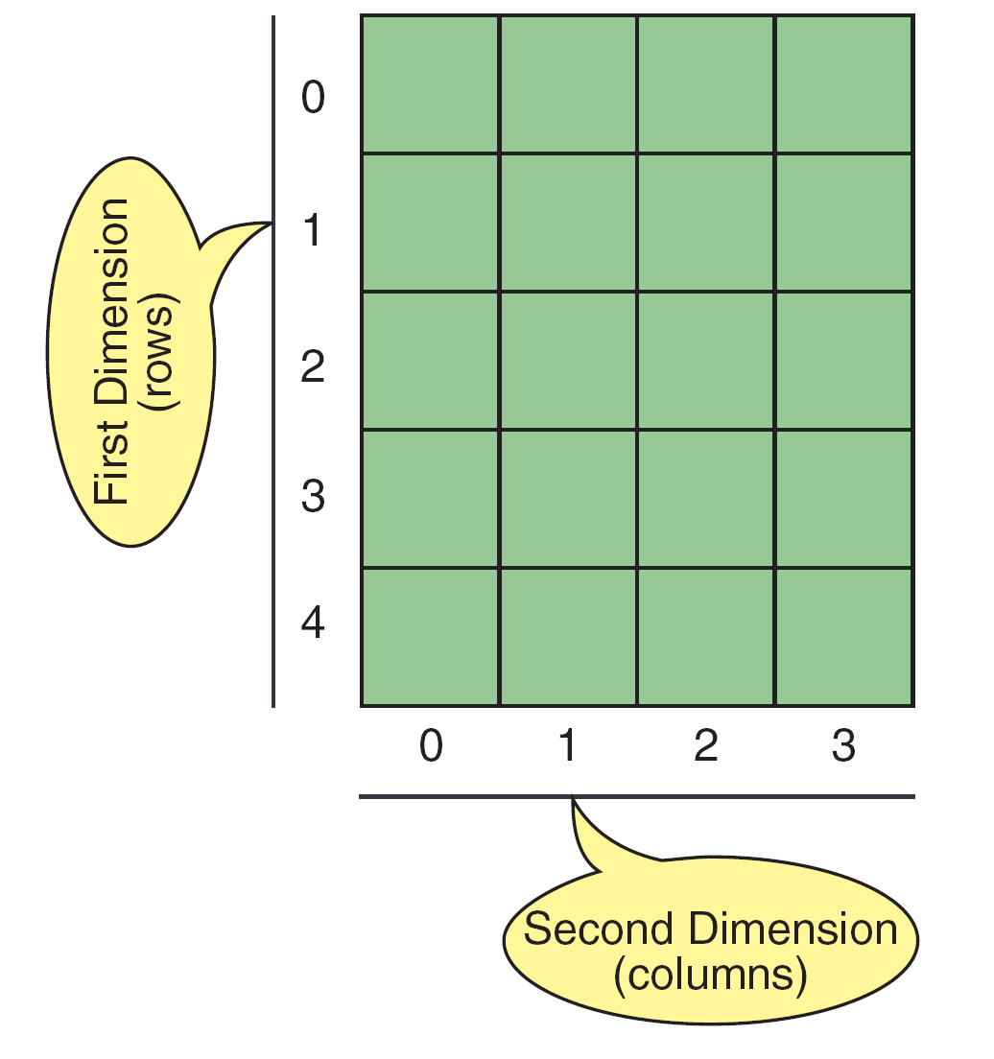
Two-Dimensional Arrays
Data is often available in tabular form
Tabular data is often represented in arrays
Matrix is an example of tabular data and is often represented as a 2-dimensional array
Two-dimensional Array

Slide 2
Two-Dimensional Arrays
A 2-D array, A with m X n elements.
In math application it is called matrix.
In business application – table.
Example:
Assume 25 students had taken 4 tests.
The marks are stored in 25 X 4 array locations:
 |  | U0 | U1 | U2 | U3
Stud 0 |  | 88 | 78 | 66 | 89
Stud 1 |  | 60 | 70 | 88 | 90
Stud 2 |  | 62 | 45 | 78 | 88
.. |  | .. | .. | .. | ..
.. |  | .. | .. | .. | ..
Stud 24 |  | 78 | 88 | 98 | 67
m
n

Slide 3
2D Arrays
The elements of a 2-dimensional array a declaredas:
int a[3][4];
may be shown as a table
a[0][0] a[0][1] a[0][2] a[0][3]
a[1][0] a[1][1] a[1][2] a[1][3]
a[2][0] a[2][1] a[2][2] a[2][3]
Notes:
What about #bytes/element of array? Excluded in above analysis.

Slide 4
Rows of a 2D Array
a[0][0] a[0][1] a[0][2] a[0][3] row 0
a[1][0] a[1][1] a[1][2] a[1][3] row 1
a[2][0] a[2][1] a[2][2] a[2][3] row 2
Notes:
What about #bytes/element of array? Excluded in above analysis.

Slide 5
Columns of a 2D Array
a[0][0] a[0][1] a[0][2] a[0][3]
a[1][0] a[1][1] a[1][2] a[1][3]
a[2][0] a[2][1] a[2][2] a[2][3]
column 0
column 1
column 2
column 3
Notes:
What about #bytes/element of array? Excluded in above analysis.

Slide 6
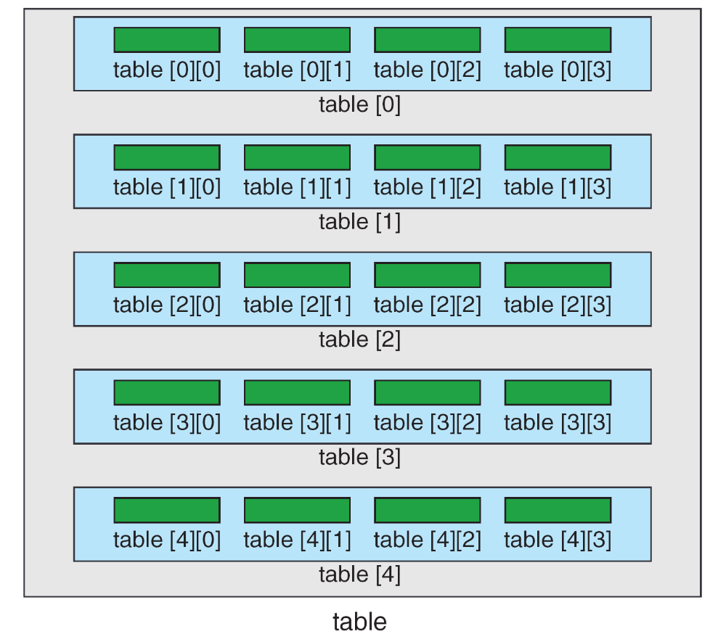
Array Of Arrays

Slide 7
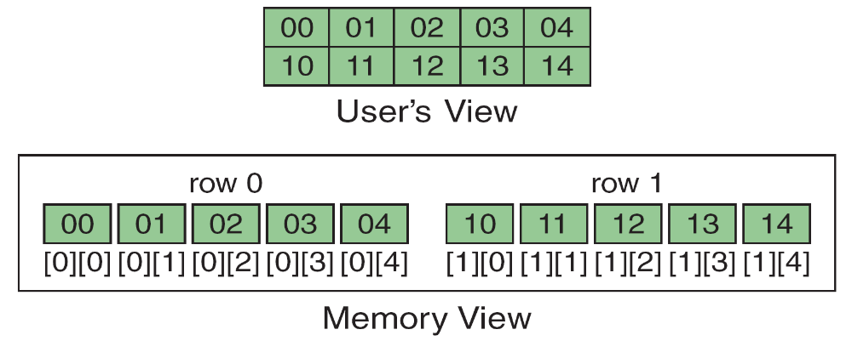
Memory Layout

Slide 8
Multidimensional Arrays
Multidimensional arrays can have three, four, or more dimensions. The first dimension is called a plane, which consists of rows and columns. The C language considers the three-dimensional array to be an array of two-dimensional arrays.

Slide 9
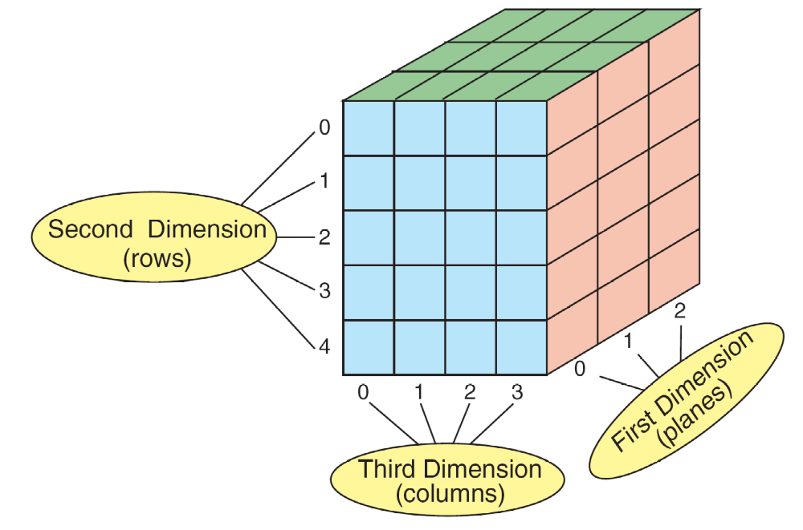
A Three-dimensional Array (3 x 5 x 4)

Slide 10
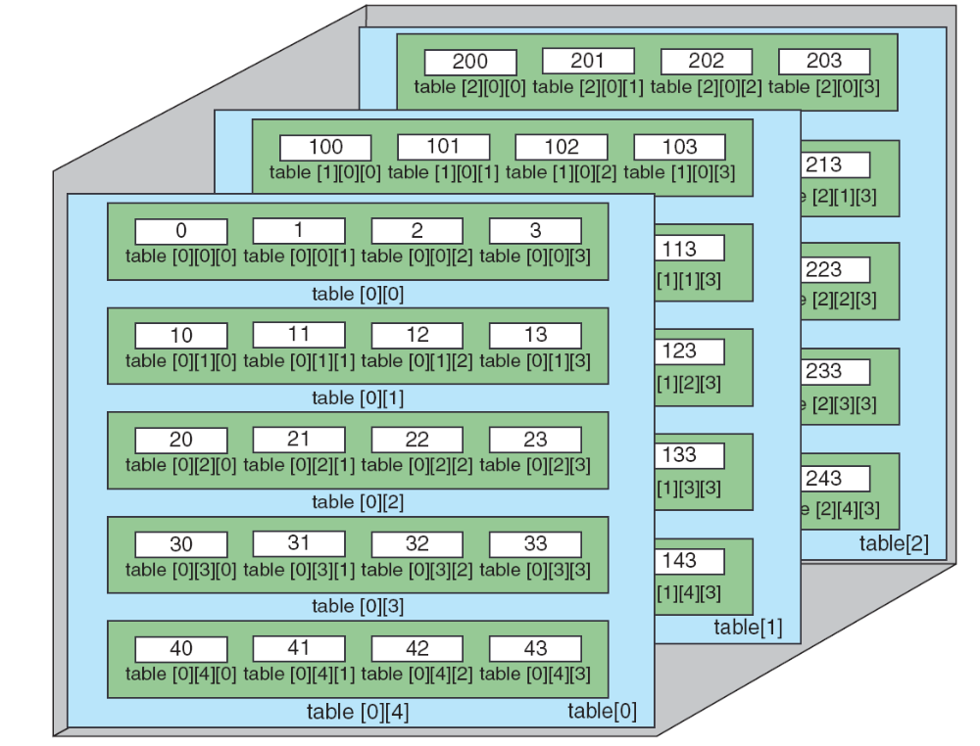
C View of Three-dimensional Array

Slide 11
Indices in 2D arrays
Assume that the two dimensional array called val is declared and looks like the following:
To access the cell containing 6, we reference val[1][3], that is, row 1, column 3.
val | Col 0 | Col 1 | Col 2 | Col 3
Row 0 | 8 | 16 | 9 | 52
Row 1 | 3 | 15 | 27 | 6
Row 2 | 14 | 25 | 2 | 10

Slide 12
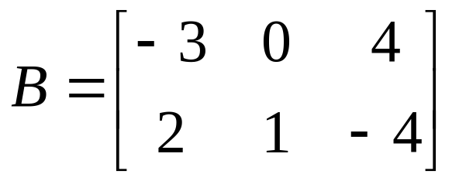
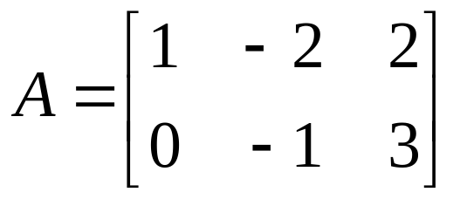
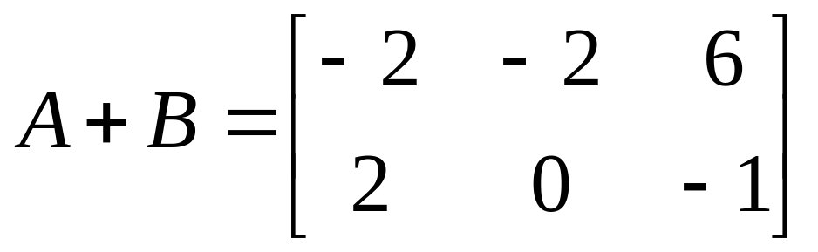
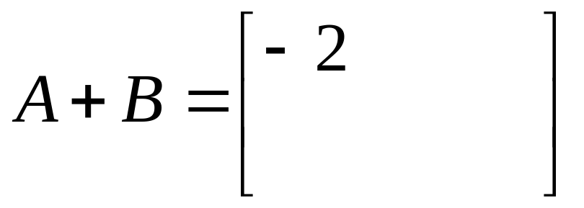
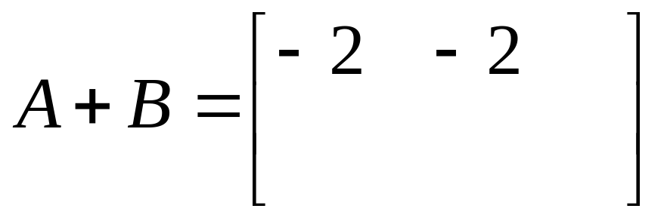
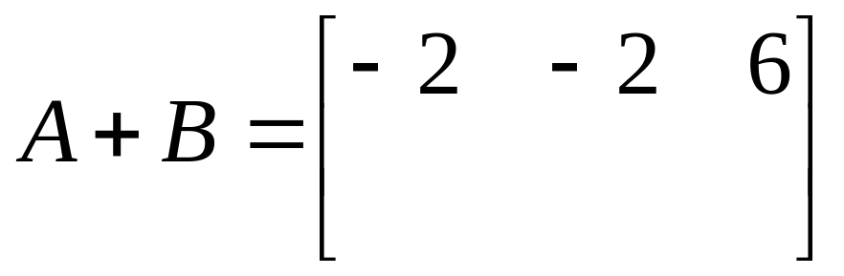
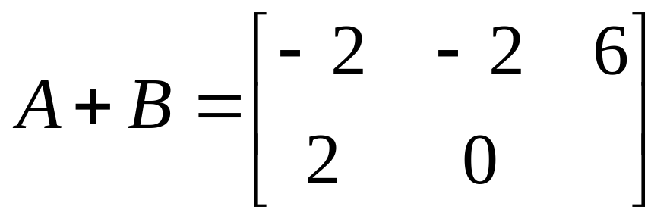
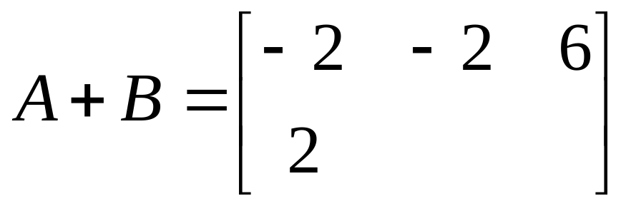
Addition of Matrices
If A and B are both m × n matrices then the sum of A and B, denoted A + B, is a matrix obtained by adding corresponding elements of A and B.
If A and B are both m × n matrices then the sum of A and B, denoted A + B, is a matrix obtained by adding corresponding elements of A and B.
add these
add these
add these
add these
add these
add these

Slide 13
Matrix Addition (I)
#include<stdio.h>
#include<string.h>
#include<conio.h>
int main(){
int a[10][10], b[10][10], c[10][10];
int R, C, i, j;
printf("Enter Row number: ");
scanf("%d",&R);
printf("Enter Column number: ");
scanf("%d",&C);

Slide 14
Matrix Addition (II)
printf("Enter First matrix of row=%d, col=%d\n",R,C);
for(i = 0; i<R; i++){
for(j = 0; j<C; j++){
scanf("%d",&a[i][j]);
}
}

Slide 15
Matrix Addition (III)
printf("Enter Second matrix of row=%d, col=%d\n",R,C);
for(i = 0; i<R; i++){
for(j = 0; j<C; j++){
scanf("%d",&b[i][j]);
}
}

Slide 16
Matrix Addition (IV)
//Now doing addition
for(i = 0; i<R; i++){
for(j = 0; j<C; j++){
c[i][j] = a[i][j] + b[i][j];
}
}

Slide 17
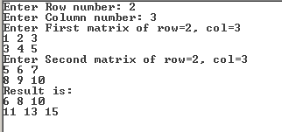
Matrix Addition (V)
//Now printing the Result matrix C
printf("Result is:\n");
for(i = 0; i<R; i++){
for(j = 0; j<C; j++){
printf("%d ",c[i][j]);
}
printf("\n");
}
return 0;
}

Slide 18
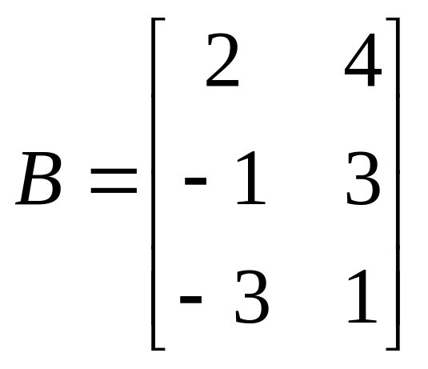
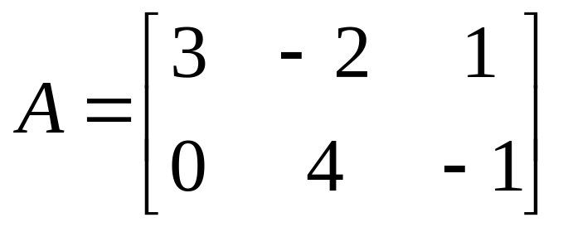
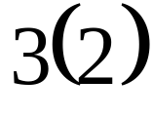
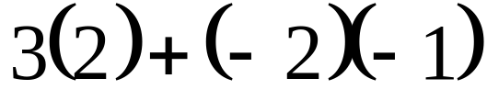
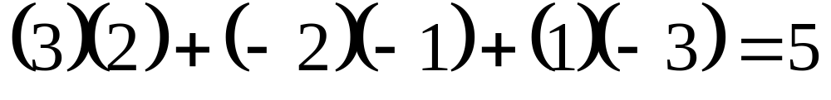
Multiplication of Matrices
The multiplication of matrices is easier shown than put into words. You multiply the rows of the first matrix with the columns of the second adding products
Find AB
First we multiply across the first row and down the first column adding products. We put the answer in the first row, first column of the answer.

Slide 19
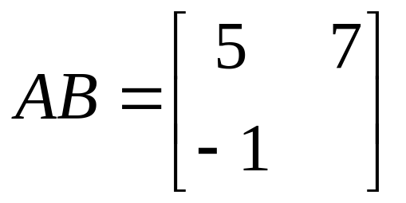
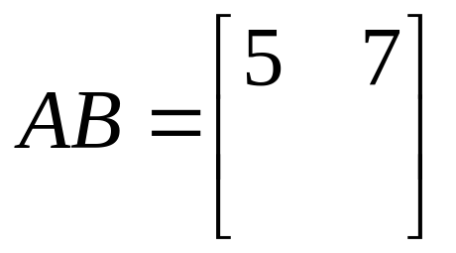
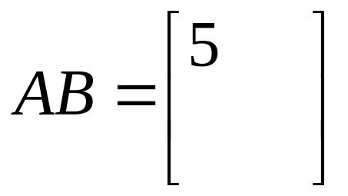
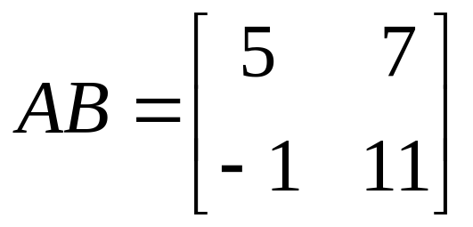
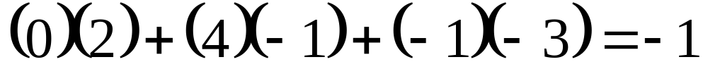
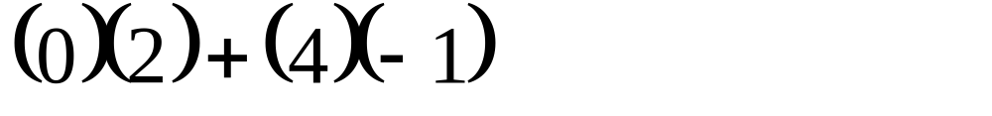
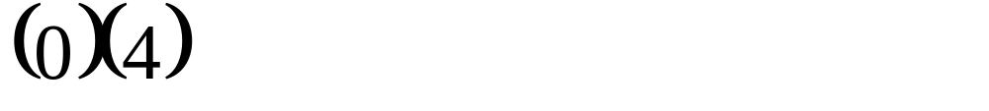
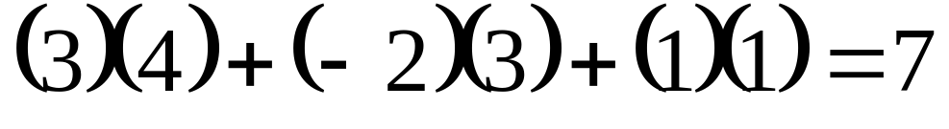
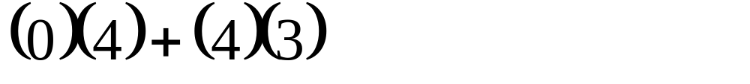
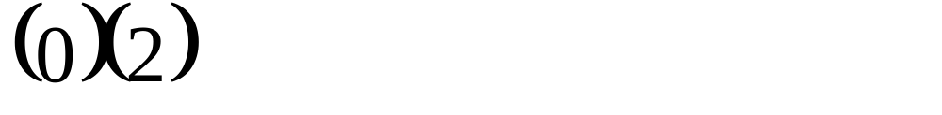
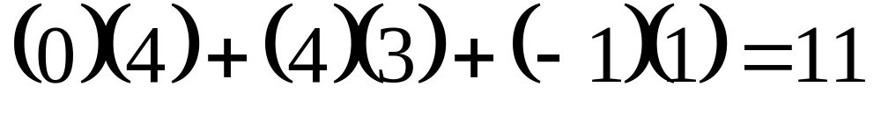
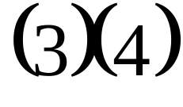
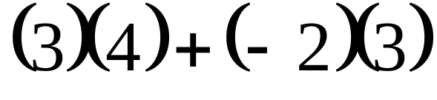
Find AB
Notice the sizes of A and B and the size of the product AB.
Now we multiply across the first row and down the second column and we’ll put the answer in the first row, second column.
Now we multiply across the second row and down the first column and we’ll put the answer in the second row, first column.
Now we multiply across the second row and down the second column and we’ll put the answer in the second row, second column.
We multiplied across first row and down first column so we put the answer in the first row, first column.

Slide 20
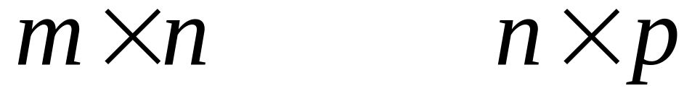
To multiply matrices A and B look at their dimensions
MUST BE SAME
SIZE OF PRODUCT
If the number of columns of A does not equal the number of rows of B then the product AB is undefined.

Slide 21
Matrix Multiplication (I)
#include<stdio.h>
int main(){
int a[5][5],b[5][5],c[5][5],i,j,k,sum=0,m,n,o,p;
printf("\nEnter the row and column of first matrix");
scanf("%d %d",&m,&n);
printf("\nEnter the row and column of second matrix");
scanf("%d %d",&o,&p);
if(n!=o){
printf("Matrix mutiplication is not possible");
}

Slide 22
Matrix Multiplication (II)
else{
printf("\nEnter the First matrix->");
for(i=0;i<m;i++)
for(j=0;j<n;j++)
scanf("%d",&a[i][j]);
printf("\nEnter the Second matrix->");
for(i=0;i<o;i++)
for(j=0;j<p;j++)
scanf("%d",&b[i][j]);

Slide 23
Matrix Multiplication (III)
for(i=0;i<m;i++)
for(j=0;j<p;j++)
c[i][j]=0;
for(i=0;i<m;i++){ //row of first matrix
for(j=0;j<p;j++){ //column of second matrix
sum=0;
for(k=0;k<n;k++)
sum=sum+a[i][k]*b[k][j];
c[i][j]=sum;
}
}
}

Slide 24
Matrix Multiplication (IV)
printf("\nThe multiplication of two matrix is\n");
for(i=0;i<m;i++){
printf("\n");
for(j=0;j<p;j++){
printf("%d\t",c[i][j]);
}
}
return 0;
}

Slide 25
Row-wise and
Column-wise sum

Slide 26
Taking input (I)
#include<stdio.h>
#include<string.h>
#include<conio.h>
void main ()
{
int array[10][10];
int i, j, m, n, sum = 0;
printf("Enter the order of the matrix\n");
scanf("%d %d", &m, &n);

Slide 27
Taking input (II)
for (i = 0; i < m; ++i)
{
for (j = 0; j < n; ++j)
{
scanf("%d", &array[i][j]);
}
}

Slide 28
Row-wise sum(III)
for (i = 0; i < m; ++i)
{
for (j = 0; j < n; ++j)
{
sum = sum + array[i][j] ;
}
printf("Sum of the %d row is = %d\n", i, sum);
sum = 0;
}

Slide 29
Column-wise sum(IV)
sum = 0;
for (j = 0; j < n; ++j)
{
for (i = 0; i < m; ++i)
{
sum = sum + array[i][j];
}
printf("Sum of the %d column is = %d\n", j, sum);
sum = 0;
}
}

Slide 30
Assignment on Matrices
Matrix Multiplication

Slide 31
Irregular 2D Arrays
x[]
1
2
3
4
5
6
7
8
9
l0
Irregular 2-D array: the length of rows is not required to be the same.

